Slide 1
Latent Semantic Analysis
Hongning Wang
CS@UVa

Slide 2
Recap: vector space model
Represent both doc and query by concept vectors
Each concept defines one dimension
K concepts define a high-dimensional space
Element of vector corresponds to concept weight
E.g., d=(x₁,…,x_{k}), x_{i} is “importance” of concept i
Measure relevance
Distance between the query vector and document vector in this concept space

Slide 3
Recap: what is a good “basic concept”?
Orthogonal
Linearly independent basis vectors
“Non-overlapping” in meaning
No ambiguity
Weights can be assigned automatically and accurately
Existing solutions
Terms or N-grams, i.e., bag-of-words
Topics, i.e., topic model
We will come back to this later

Slide 4
Recap: TF weighting
Two views of document length
A doc is long because it is verbose
A doc is long because it has more content
Raw TF is inaccurate
Document length variation
“Repeated occurrences” are less informative than the “first occurrence”
Relevance does not increase proportionally with number of term occurrence
Generally penalize long doc, but avoid over-penalizing
Pivoted length normalization

Slide 5
Recap: IDF weighting
Solution
Assign higher weights to the rare terms
Formula
$IDF\left(t\right)=1+log⁡(\frac{N}{df(t)})$
A corpus-specific property
Independent of a single document
Non-linear scaling
Total number of docs in collection
Number of docs containing term $t$

Slide 6
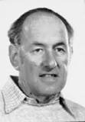
Recap: TF-IDF weighting
Combining TF and IDF
Common in doc → high tf → high weight
Rare in collection→ high idf→ high weight
$w\left(t,d\right)=TF\left(t,d\right)×IDF(t)$
Most well-known document representation schema in IR! (G Salton et al. 1983)
“Salton was perhaps the leading computer scientist working in the field of information retrieval during his time.” - wikipedia
Gerard Salton Award
– highest achievement award in IR

Slide 7
Recap: cosine similarity
Angle between two vectors
$cosine\left(V_{q},V_{d}\right)=\frac{V_{q}×V_{d}}{{\left|V_{q}\right|}_{2}×{\left|V_{d}\right|}_{2}}=\frac{V_{q}}{{\left|V_{q}\right|}_{2}}×\frac{V_{d}}{{\left|V_{d}\right|}_{2}}$
Document length normalized
TF-IDF vector
Unit vector
Finance
D₂
TF-IDF space
D₁
Query
Sports

Slide 8
Recap: disadvantages of VS Model
Assume term independence
Assume query and document to be the same
Lack of “predictive adequacy”
Arbitrary term weighting
Arbitrary similarity measure
Lots of parameter tuning!

Slide 9
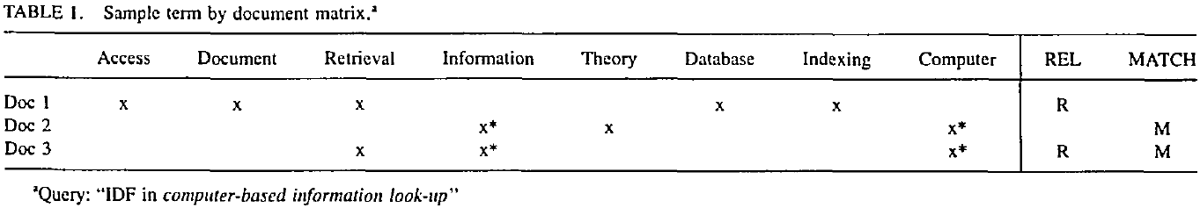
VS model in practice
Document and query are represented by term vectors
Terms are not necessarily orthogonal to each other
Synonymy: car v.s. automobile
Polysemy: fly (action v.s. insect)

Slide 10
Choosing basis for VS model
A concept space is preferred
Semantic gap will be bridged
Finance
D₂
D₄
D₃
Sports
Query
D₁
Education
D₅

Slide 11
How to build such a space
Automatic term expansion
Construction of thesaurus
WordNet
Clustering of words
Word sense disambiguation
Dictionary-based
Relation between a pair of words should be similar as in text and dictionary’s description
Explore word usage context

Slide 12
How to build such a space
Latent Semantic Analysis
Assumption: there is some underlying latent semantic structure in the data that is partially obscured by the randomness of word choice with respect to retrieval
It means: the observed term-document association data is contaminated by random noise

Slide 13
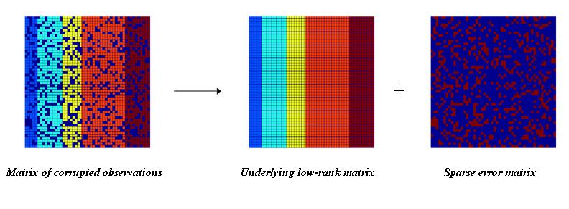
How to build such a space
Solution
Low rank matrix approximation
Imagine this is *true* concept-document matrix
Imagine this is our observed term-document matrix
Random noise over the word selection in each document

Slide 14
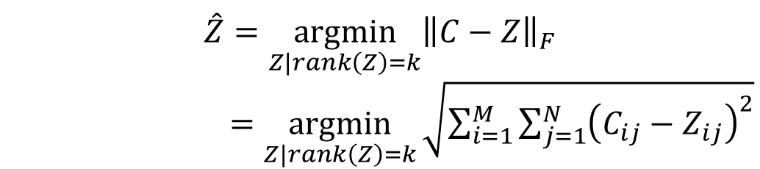
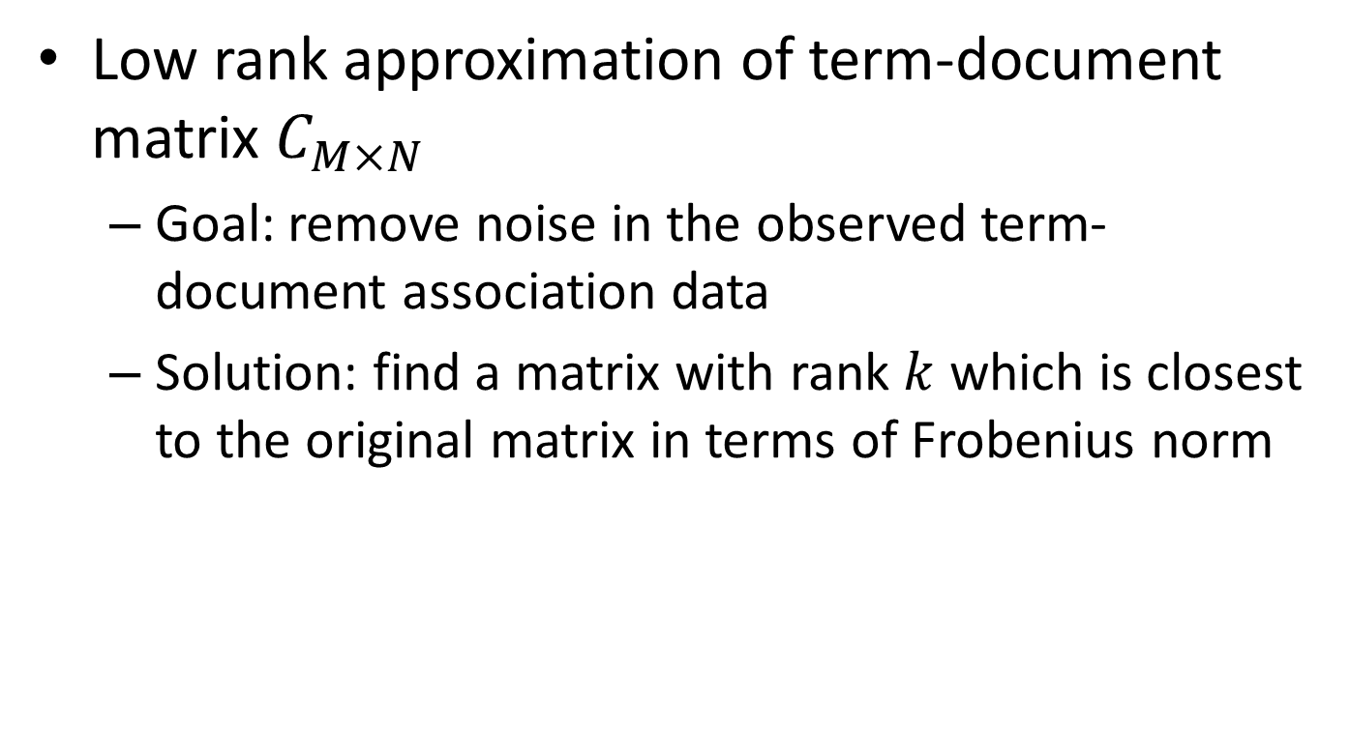
Latent Semantic Analysis (LSA)
Low rank approximation of term-document matrix $C_{M×N}$
Goal: remove noise in the observed term-document association data
Solution: find a matrix with rank $k$ which is closest to the original matrix in terms of Frobenius norm
$$\hat{Z}=\underset{Z|rank\left(Z\right)=k}{argmin}{{\left\|C−Z\right\|}_{F}}$$
$=\underset{Z|rank\left(Z\right)=k}{argmin}{\sqrt{\sum_{i=1}^{M}{\sum_{j=1}^{N}{{\left(C_{ij}−Z_{ij}\right)}^{2}}}}}$

Slide 15
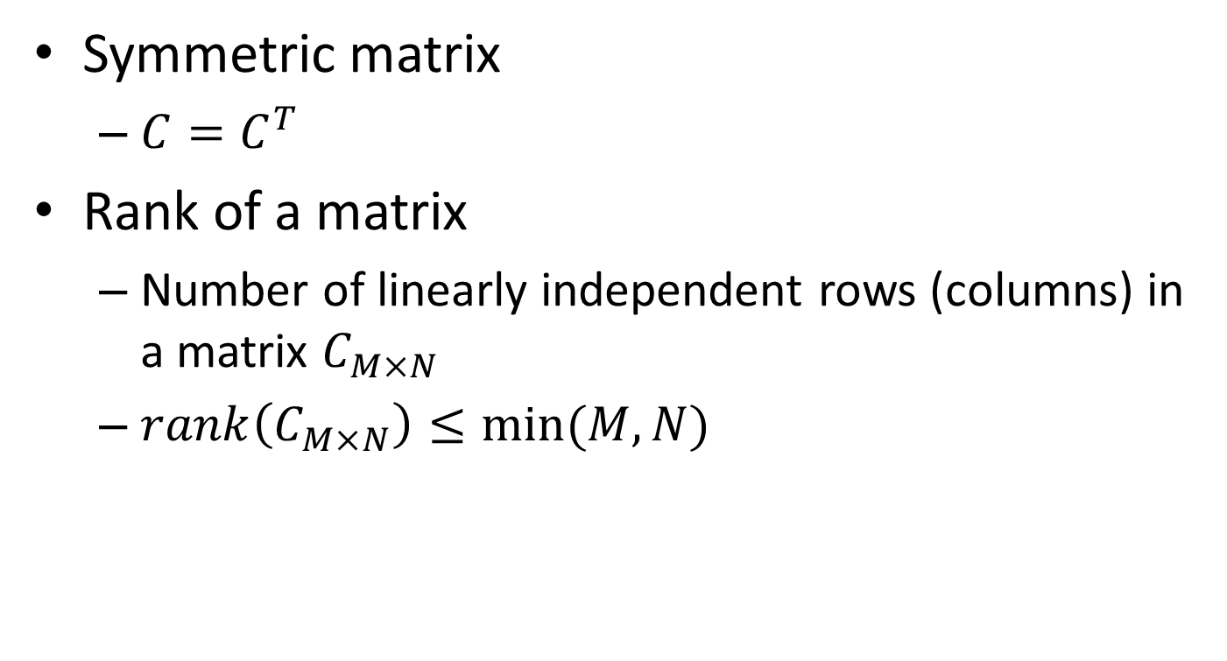
Basic concepts in linear algebra
Symmetric matrix
$C=C^{T}$
Rank of a matrix
Number of linearly independent rows (columns) in a matrix $C_{M×N}$
$rank\left(C_{M×N}\right)≤min⁡(M,N)$

Slide 16
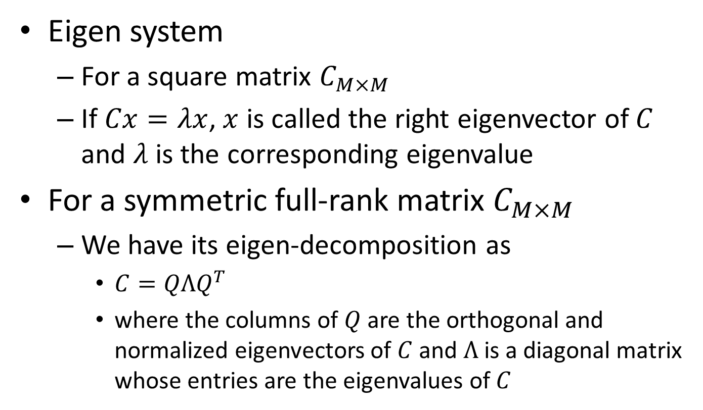
Basic concepts in linear algebra
Eigen system
For a square matrix $C_{M×M}$
If $Cx=λx$, $x$ is called the right eigenvector of $C$ and $λ$ is the corresponding eigenvalue
For a symmetric full-rank matrix $C_{M×M}$
We have its eigen-decomposition as
$C=QΛQ^{T}$
where the columns of $Q$ are the orthogonal and normalized eigenvectors of $C$ and $Λ$ is a diagonal matrix whose entries are the eigenvalues of $C$

Slide 17
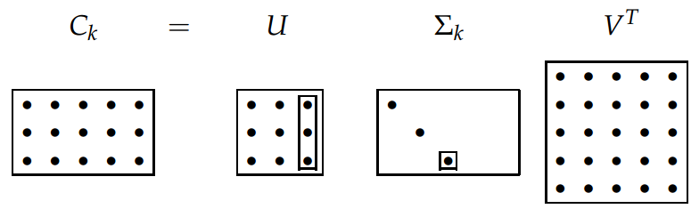

Basic concepts in linear algebra
Singular value decomposition (SVD)
For matrix $C_{M×N}$ with rank $r$, we have
$C=UΣV^{T}$
where $U_{M×r}$ and $V_{N×r}$ are orthogonal matrices, and $Σ$ is a $r×r$ diagonal matrix, with $Σ_{ii}=\sqrt{λ_{i}}$ and $λ_{1}…λ_{r}$ are the eigenvalues of $CC^{T}$
We define $C_{M×N}^{k}=U_{M×k}Σ_{k×k}V_{N×k}^{T}$
where we place $Σ_{ii}$ in a descending order and set $Σ_{ii}=\sqrt{λ_{i}}$ for $i≤k$, and $Σ_{ii}=0$ for $i>k$

Slide 18
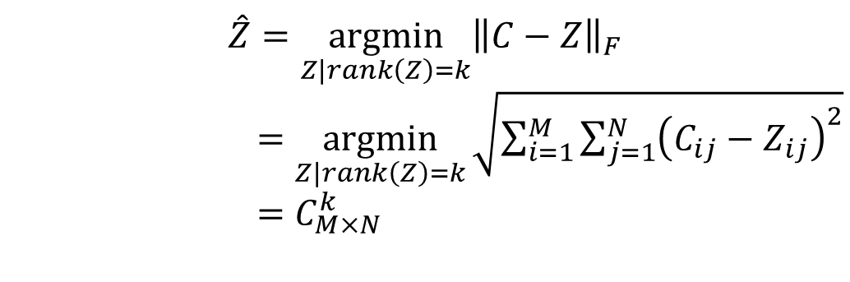

Latent Semantic Analysis (LSA)
Solve LSA by SVD
Procedure of LSA
Perform SVD on document-term adjacency matrix
Construct $C_{M×N}^{k}$ by only keeping the largest $k$ singular values in $Σ$ non-zero
Map to a lower dimensional space
$$\hat{Z}=\underset{Z|rank\left(Z\right)=k}{argmin}{{\left\|C−Z\right\|}_{F}}$$
$=\underset{Z|rank\left(Z\right)=k}{argmin}{\sqrt{\sum_{i=1}^{M}{\sum_{j=1}^{N}{{\left(C_{ij}−Z_{ij}\right)}^{2}}}}}$
$=C_{M×N}^{k}$

Slide 19
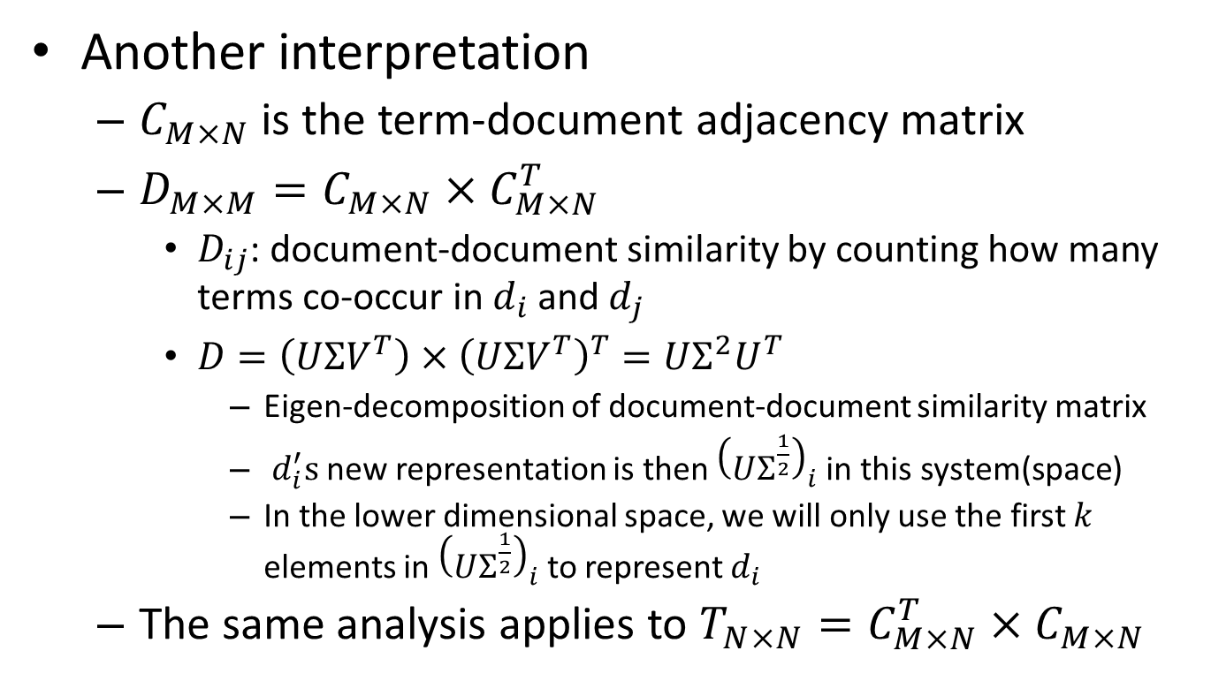
Latent Semantic Analysis (LSA)
Another interpretation
$C_{M×N}$ is the term-document adjacency matrix
${D_{M×M}=C}_{M×N}×C_{M×N}^{T}$
$D_{ij}$: document-document similarity by counting how many terms co-occur in $d_{i}$ and $d_{j}$
$D=\left(UΣV^{T}\right)×{\left(UΣV^{T}\right)}^{T}=UΣ^{2}U^{T}$
Eigen-decomposition of document-document similarity matrix
$d_{i}^{′}s$new representation is then ${\left(UΣ^{\frac{1}{2}}\right)}_{i}$ in this system(space)
In the lower dimensional space, we will only use the first $k$ elements in ${\left(UΣ^{\frac{1}{2}}\right)}_{i}$ to represent $d_{i}$
The same analysis applies to ${T_{N×N}=C}_{M×N}^{T}×C_{M×N}$

Slide 20
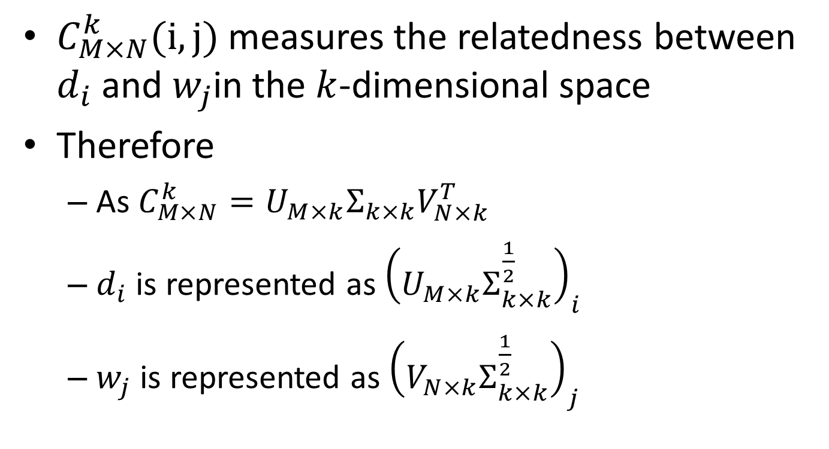
Geometric interpretation of LSA
$C_{M×N}^{k}(i,j)$ measures the relatedness between $d_{i}$ and $w_{j}$in the $k$-dimensional space
Therefore
As$C_{M×N}^{k}=U_{M×k}Σ_{k×k}V_{N×k}^{T}$
$d_{i}$ is represented as ${\left(U_{M×k}Σ_{k×k}^{\frac{1}{2}}\right)}_{i}$
$w_{j}$ is represented as ${\left(V_{N×k}Σ_{k×k}^{\frac{1}{2}}\right)}_{j}$

Slide 21
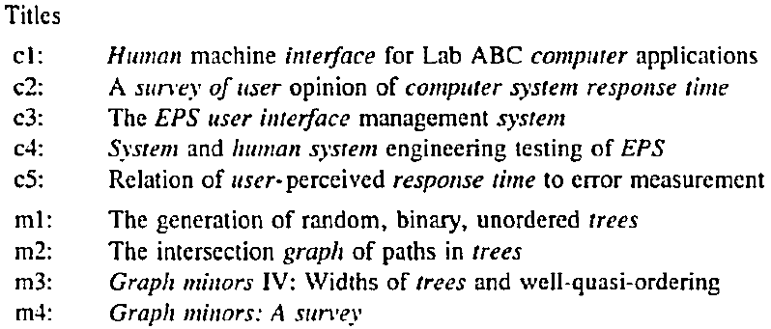
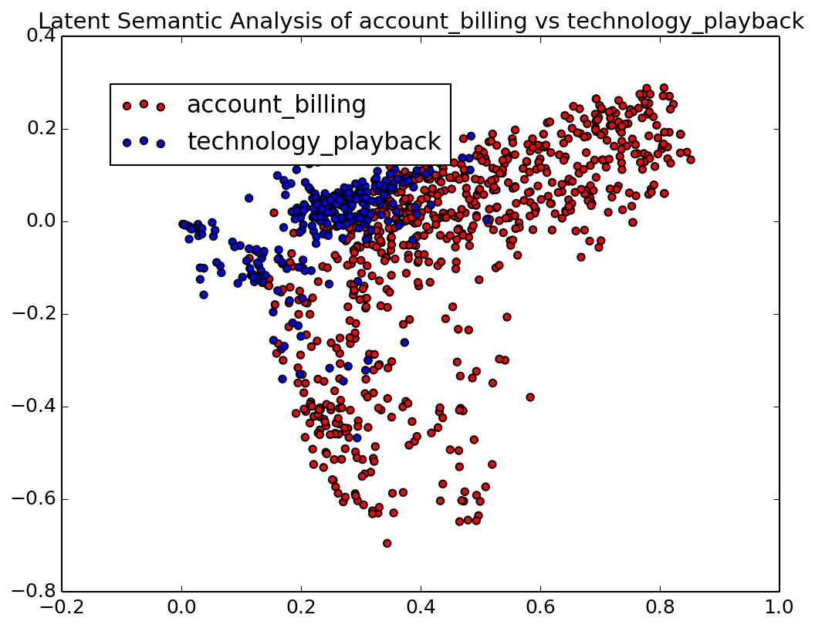
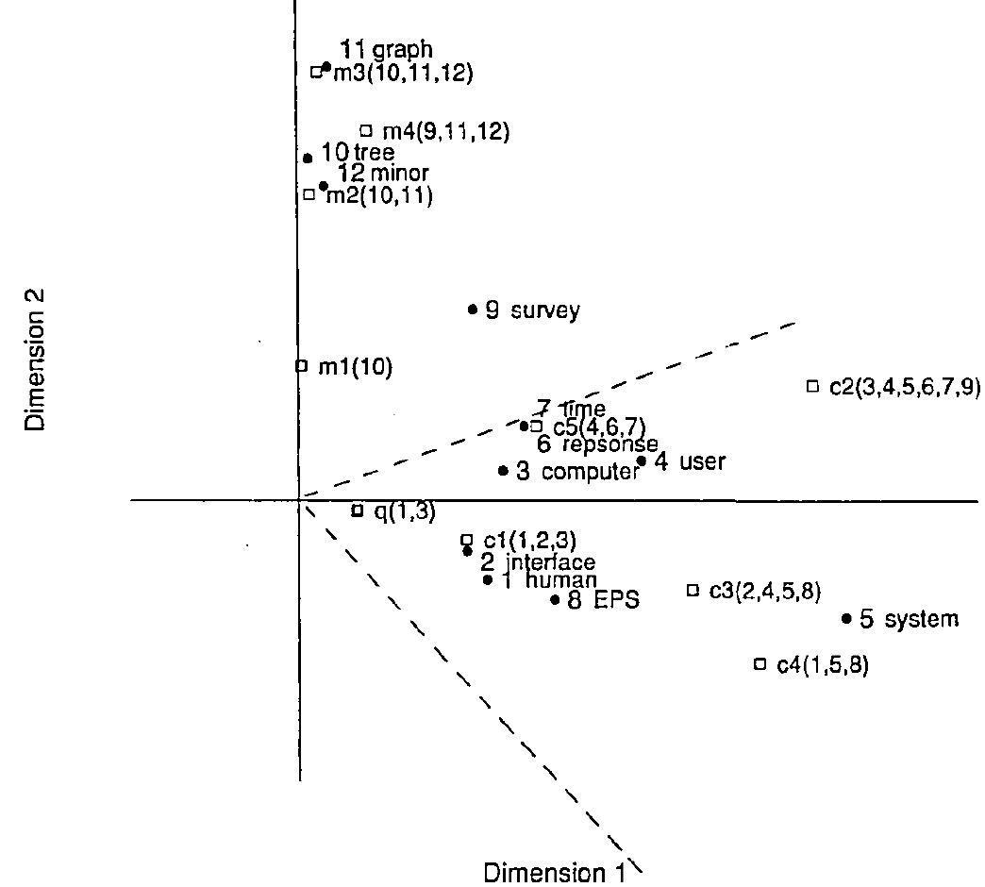
Latent Semantic Analysis (LSA)
HCI
Visualization
Graph theory

Slide 22
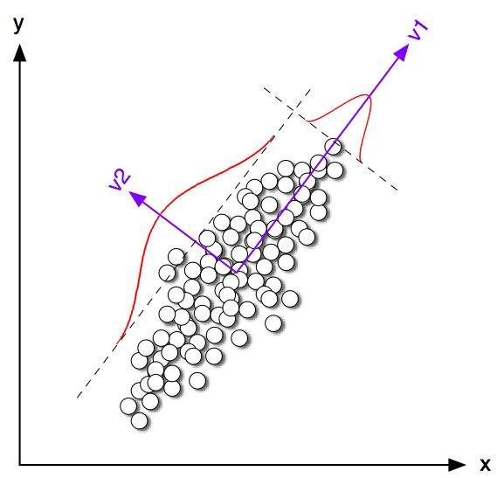
What are those dimensions in LSA
Principle component analysis

Slide 23
Latent Semantic Analysis (LSA)
What we have achieved via LSA
Terms/documents that are closely associated are placed near one another in this new space
Terms that do not occur in a document may still close to it, if that is consistent with the major patterns of association in the data
A good choice of concept space for VS model!

Slide 24
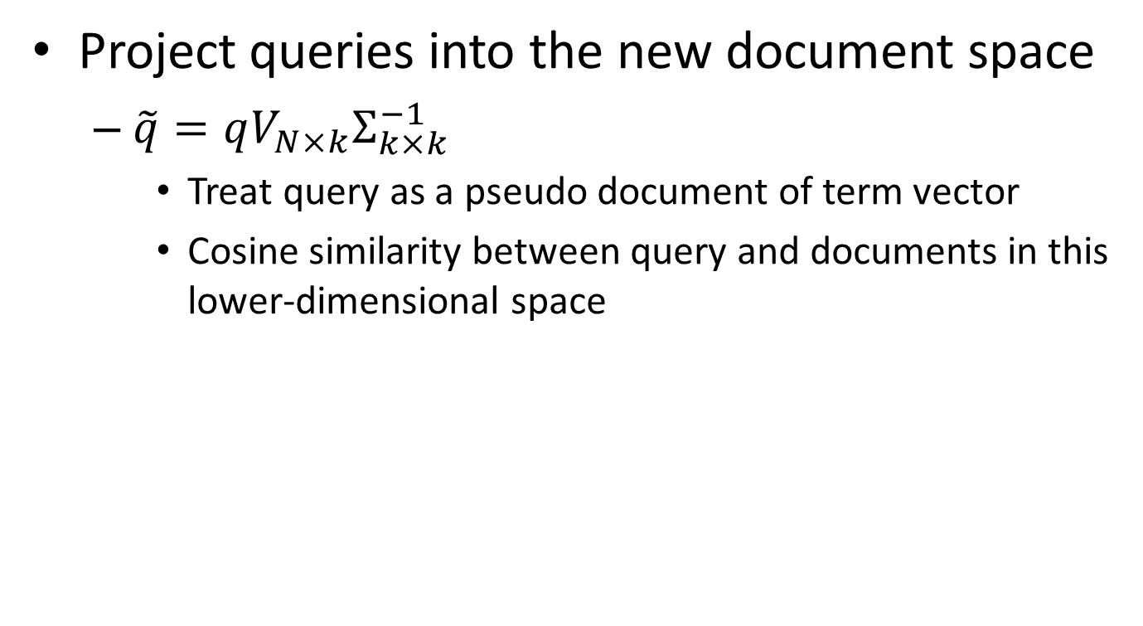
LSA for retrieval
Project queries into the new document space
$\tilde{q}=qV_{N×k}Σ_{k×k}^{−1}$
Treat query as a pseudo document of term vector
Cosine similarity between query and documents in this lower-dimensional space

Slide 25
LSA for retrieval
HCI
Graph theory
q: “human computer interaction”

Slide 26
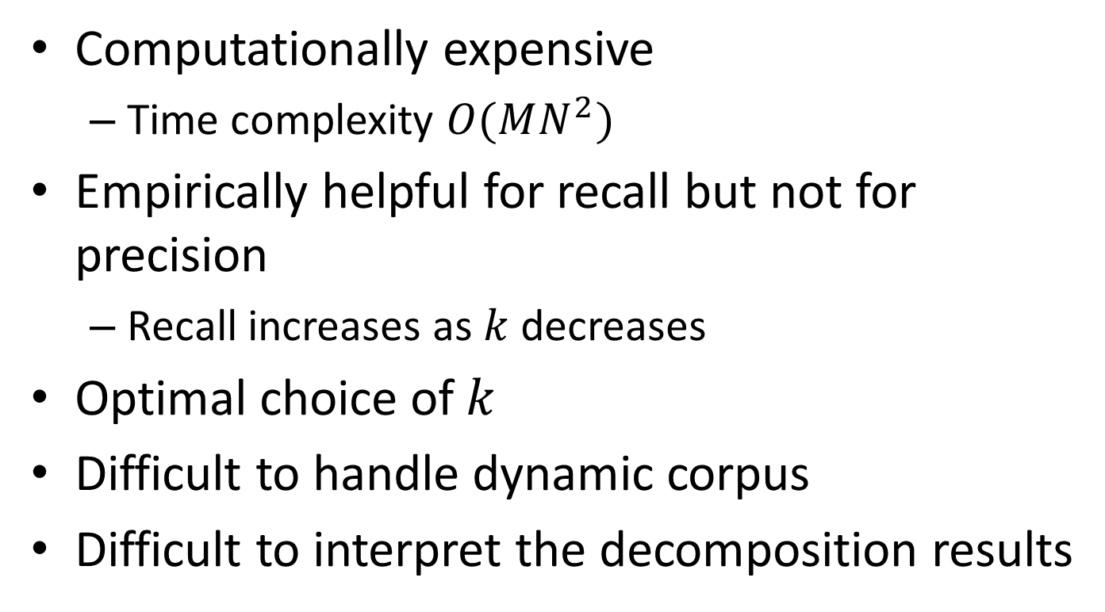
Discussions
Computationally expensive
Time complexity $O(MN^{2})$
Empirically helpful for recall but not for precision
Recall increases as $k$ decreases
Optimal choice of $k$
Difficult to handle dynamic corpus
Difficult to interpret the decomposition results
We will come back to this later!

Slide 27
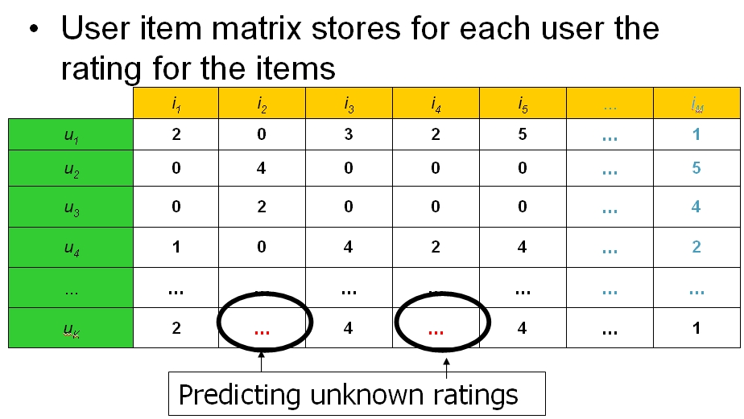
LSA beyond text
Collaborative filtering

Slide 28
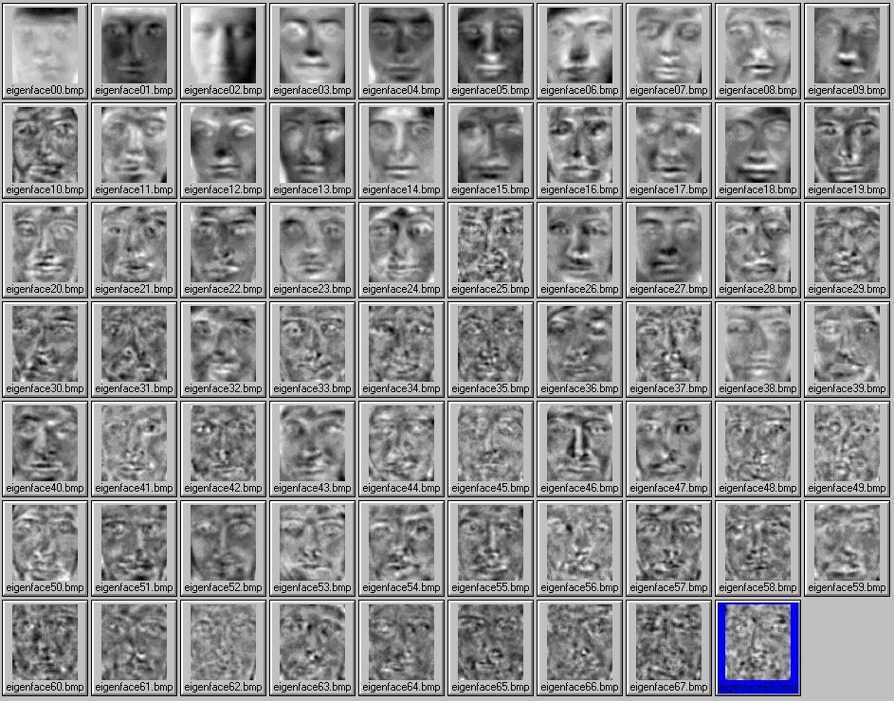
LSA beyond text
Eigen face

Slide 29
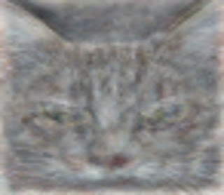
LSA beyond text
Cat from deep neuron network
One of the neurons in the artificial neural network, trained from still frames from unlabeled YouTube videos, learned to detect cats.

Slide 30
What you should know
Assumption in LSA
Interpretation of LSA
Low rank matrix approximation
Eigen-decomposition of co-occurrence matrix for documents and terms
LSA for IR

Slide 31
Today’s reading
Chapter 13: Matrix decompositions and latent semantic indexing
All the chapters!
Deerwester, Scott C., et al. "Indexing by latent semantic analysis." JAsIs 41.6 (1990): 391-407.

